Slide 1
Co-existence of R and SAS for multiple imputation in Novo Nordisk
Claus Dethlefsen^{1,3}, Mette Dahl Bendtsen¹, Jacob B. Jacobsen¹, Christian Hollensen², Henrik F. Thomsen¹, Kristoffer Segerstrøm Mørk¹ ¹Department of Biostatistics, Novo Nordisk, Aalborg, Denmark ²Department of Pharmacometrics, Novo Nordisk, Søborg, Denmark ³Department of Mathematical Sciences, Aalborg University, Aalborg, Denmark

Slide 2
Disclaimer
Views and opinions expressed are those of the speaker and not necessarily Novo Nordisk

Slide 3
Trial design
Trial information
Treatment A
Treatment B
Double blinded
Randomisation stratified by region
Patients that discontinue treatment, continue in trial
~700 patients
Treatment C
Placebo
Duration (weeks)
0
Randomisation (1:1:1:1)
End of treatment
Trial objective
To demonstrate superiority of Treatment A, B, and C versus Placebo on percent change in Y from baseline to End of treatment
Trial Estimand
Treatment difference between Treatment A, B, and C vs. placebo on the percent change in Y from baseline to End of treatment, regardless of premature trial treatment discontinuation.
Key endpoints
Primary: Percent change from baseline to End of treatment in Y

Slide 4


Intercurrent events
Randomisation
End of treatment
Patient 1
Patient 4
Patient 5
Patient 7
Rescue medication
Treatment A
Treatment discontinuation due to adverse event
Rescue medication
Treatment discontinuation due to adverse event
Patient 2
Patient 3
Patient 6
Patient 8
Treatment discontinuation due to lack of efficacy
Placebo
Death
Withdrawal of consent
https://database.ich.org/sites/default/files/E9%28R1%29%20Training%20Material%20-%20PDF_0.pdf

Slide 5
Clinical questions
What is the treatment effect of Treatment A versus placebo on change in Y from baseline to week T in participants with “Disease”, regardless of change in background medication and/or premature treatment discontinuation?
What is the treatment effect of Treatment A versus placebo on change in Y from baseline to week T in participants with “Disease” as if all participants adhered to treatment and no rescue treatment was available?

Slide 6
“As if all adhered”
Randomised to Placebo
0.6
0.4
Change from baseline in Y
Randomised to
Treatment A
0.2
1
2
3
4
5
6
Time
Observed value
Missing value

Slide 7
Alternative?
Randomised to Placebo
0.6
0.4
Change from baseline in Y
Randomised to
Treatment A
0.2
1
2
3
4
5
6
Time
Observed value
Missing value

Slide 8
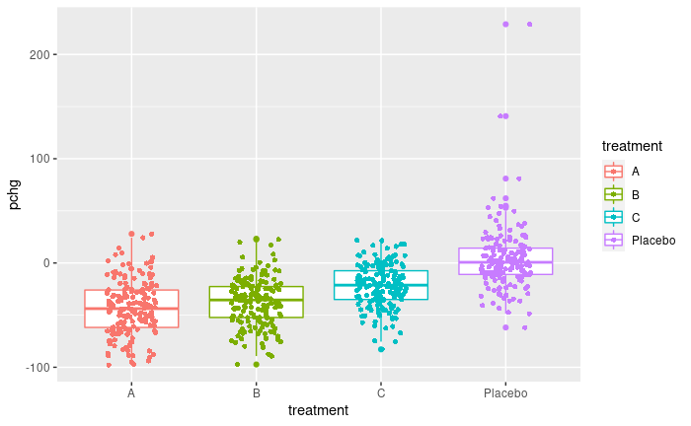
Statistical analysis
Treatment policy estimand
Percent change in Y is an analysis of covariance with treatment and region as factors and baseline Y as a covariate, allowing for different variation in treatments.
Missing end-of-treatment data are imputed based on available values within imputation groups defined by randomised treatment and treatment status (on/off) at end of treatment.

Slide 9
Simulated data
Treatment discontinuers in active arms loose 50% of effect
Randomly introduce ~10% missing endpoint
Treatment | Mean pchg | SD | N | N off treatment | Missing
Placebo | 5 | 20 | 177 | 43 | 26
A | -50 | 25 | 174 | 23 | 17
B | -40 | 24 | 174 | 22 | 18
C | -25 | 22 | 173 | 25 | 21
Pchg = Percent change from baseline
SD = Standard Deviation
N = Number of subjects

Slide 10

Mission
Let it be independent of programming language to conduct the analysis and review

Slide 11
Essential SAS code for statistical analysis
proc mi data = amp out = imputed nimpute = 500 seed = 20221104;
class region; by treatment status; monotone reg (aval=region base); var region base aval; run;
ods output lsmeans=LSMeans diffs=LSMdiffs;
proc mixed data=imputed; class treatment region; by IMPN; model pchg = treatment region base; repeated /group=treatment; lsmeans treatment /diff om at means; run;
proc mianalyze data=LSMdiffs(where=(_treatment="Placebo")) alpha=0.05 edf=687;
by treatment _treatment; modeleffects estimate; stderr stderr; ods output ParameterEstimates = LSMdiffs_comb; run;
Data steps and sorting omitted
pchg is calculated from imputed aval
edf specified for corrected degrees of freedom in Rubins rules (Barnard and Rubin, 1999) as implemented in R
Allow different variances for treatment (repeated)

Slide 12
Essential R code for statistical analysis
library(mice) library(miceadds)
method <- rep("", ncol(amp)) names(method) <- colnames(amp) method["aval"] <- "bygroup" R.imputed <- mice(imp, method = method, group = list("aval" = "mygroup"), m = 500, seed = 20221104, predictorMatrix = predictorMatrix, imputationFunction = list("aval" = "norm") )
fit <- with(R.imputed, gls( 100*(aval - base)/base ~ treatment + region + base, weights = varIdent(form = ~1 | treatment) ) ) est <- pool(fit)
Use miceadds for grouped imputation
mygroup contains combinations of treatment and status
Allow different variances for treatment with gls()
predictorMatrix specifies that aval is imputed from region and base

Slide 13
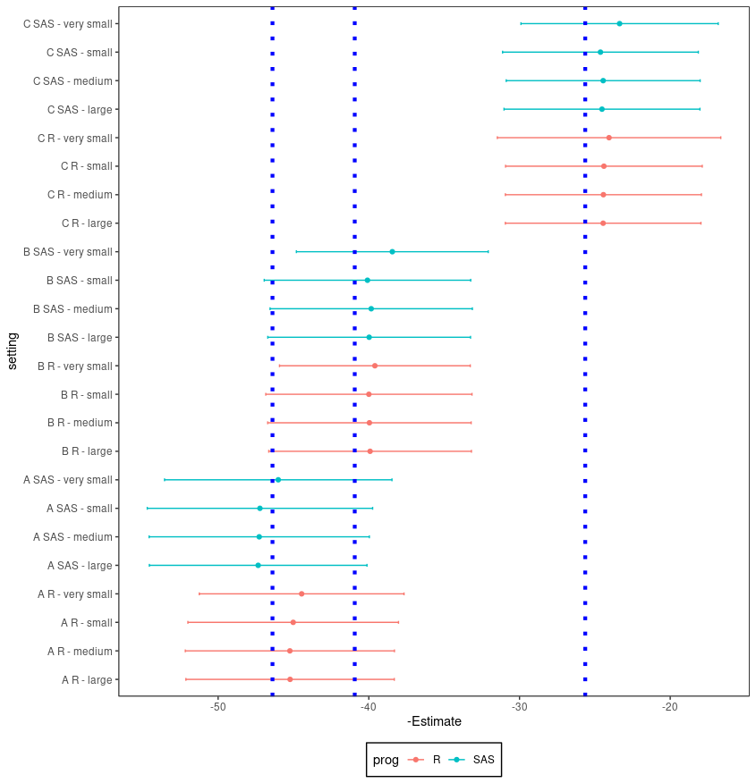
Results
C
Number of imputations 5, 50, 500, 5000
Estimated treatment difference vs placebo for treatment A, B, C
Dotted lines show treatment differences estimated from full simulated dataset with no missing
B
A

Slide 14
Comparison
From imputed datasets, gls() and proc mixed yield very similar results (except for degrees of freedom which may impact small samples)
Models fitted from imputed datasets yield exactly the same pooled estimates using Rubin’s rules, if the adjusted degrees of freedom is input to SAS using edf argument
Default random number generators for both SAS and R is a Mersenne-Twister algorithm but they do not yield the same random numbers with the same seed.
Not possible to reproduce imputed values from SAS
Increasing number of imputations does not always yield results closer between R and SAS, but seems within variation of changing seeds

Slide 15
Recommendation
Approach 1. Pre-specify in tedious details in Statistical Analysis Plan. Seed, sorting, number of imputations, programming language.
Approach 2. Pre-specify more high-level and be careful to evaluate impact of changing seed, number of imputations, etc. and report if results are not robust.

